Slide 1
Natural Language Processing DTS305TC
Huakang Li
Huakang.li@xjtlu.edu.cn
School of AI and Advanced Computing
Notes:
English Title: Uppercase, Calibri size 60, XJTLU Navy
English Subtitle: Uppercase, Calibri size 36, XJTLU Navy

Slide 2
Lab 5 Document Classification
week 3 day 1
https://spotintelligence.com/2023/10/23/document-classification-python/

Slide 3
Overview
Basics of Document Classification
Getting Started With Data Preparation
Machine Learning Models for Document Classification

Slide 4
Collecting a Labeled Dataset
The foundation of document classification is a labelled dataset. This dataset consists of text documents associated with a predefined category or label. The process of collecting such a dataset involves the following:
Data Sourcing: Identify and gather text documents covering the topics or categories you want to classify. This might involve web scraping, data extraction from databases, or using existing datasets.
Labelling: Manually or automatically assign labels to the documents. For instance, if you have a spam email dataset, you would mark each email as “spam” or “not spam.”
Balancing: Ensure that the dataset is balanced, meaning that each category has a sufficient number of documents for training. Imbalanced datasets can lead to biased models.

Slide 5
import pandas as pd
data = pd.read_csv('business_data.csv')
X = data['content']
y = data['category']
label_counts = y.value_counts()
print(label_counts)
category
tradee 1001
business 999
Name: count, dtype: int64

Slide 6
Data Cleaning and Preprocessing
Before feeding the data into a classification model, cleaning and preprocessing it is essential. Data cleaning and preprocessing steps typically include the following:
Text Cleaning: Remove any noise from the text data, such as HTML tags, special characters, or non-textual elements.
Lowercasing: Convert all text to lowercase to ensure consistency in text representations. This prevents the model from treating “cat” and “Cat” as different words.
Tokenization: Split the text into words or subword units. Tokenization is crucial for representing text as numerical features.
Stop Word Removal: Eliminate common words like “and,” “the,” and “in” that carry little meaning for document classification tasks.
Stemming or Lemmatization: Reduce words to their root form to ensure that different inflexions of a word are treated as the same word (e.g., “running” and “ran” to “run”).

Slide 7
def preprocess_text(text):
translator = str.maketrans('', '', string.punctuation)
text_no_punct = text.translate(translator)
text_lower = text_no_punct.lower()
tokens = word_tokenize(text_lower)
stop_words = set(stopwords.words('english'))
filtered_tokens = [word for word in tokens if word not in stop_words]
lemmatizer = WordNetLemmatizer()
lemmatized_tokens = [lemmatizer.lemmatize(word) for word in filtered_tokens]
preprocessed_text = ' '.join(lemmatized_tokens)
return preprocessed_text
import nltk
from nltk.corpus import stopwords
from nltk.stem import WordNetLemmatizer
from nltk.tokenize import word_tokenize
import string
nltk.download('stopwords')
nltk.download('wordnet')

Slide 8
How Can You Handle Imbalanced Datasets?
Imbalanced datasets are standard in document classification, where some categories may have many more examples than others. To address this, consider techniques such as:
Oversampling: Create additional copies of minority class samples to balance the dataset.
Undersampling: Reduce the number of majority class samples to balance the dataset.
Synthetic Data Generation: Use techniques like SMOTE (Synthetic Minority Over-sampling Technique) to generate synthetic examples for minority classes.
Evaluation Metrics: Use appropriate metrics like F1-score, precision-recall, or ROC-AUC, which are more robust for imbalanced datasets than accuracy.

Slide 9
Text Feature Extraction Techniques
After data preprocessing, you need to convert the text data into numerical features that machine learning models can use. Standard text feature extraction techniques include:
Bag of Words (BoW): Represent each document as a vector of word frequencies. Each word is a feature, and its frequency in the document is its value.
Term Frequency-Inverse Document Frequency (TF-IDF): Weigh words based on their importance in a document relative to their significance in a corpus. It helps identify words that are discriminative for a category.
Word Embeddings: This method utilizes pre-trained word vectors (e.g., Word2Vec, GloVe, fastText) to represent words and documents in a continuous vector space.

Slide 10
# Vectorize the text data using TF-IDF
vectorizer = TfidfVectorizer(max_features=5000)
X_train = vectorizer.fit_transform(X_train)
X_test = vectorizer.transform(X_test)
# Encode labels
label_encoder = LabelEncoder()
y_train = label_encoder.fit_transform(y_train)
y_test = label_encoder.transform(y_test)

Slide 11
Machine Learning Models
Machine learning models are designed to learn patterns and relationships within data, making them well-suited for document classification. Here are the key concepts to understand:
Supervised Learning: Document classification is primarily a supervised learning task. It means the model learns from labelled examples where the text document and its associated category are provided during training.
Feature Vectors: Text data must be transformed into numerical feature vectors for input for machine learning models. This is typically achieved through techniques like Bag of Words (BoW), Term Frequency-Inverse Document Frequency (TF-IDF), or word embeddings.
Classification Algorithms: Machine learning models predict the category of a document by mapping its feature vector to one of the predefined categories. Common classification algorithms include Naive Bayes, Support Vector Machines (SVM), and Random Forest.

Slide 12
Top 4 Algorithms for Document Classification
1. Naive Bayes:
Pros: Simple, efficient, and effective for text classification. Works well even with small datasets.
Cons: Assumes independence between features (words), which may not always hold in text data.
2. Support Vector Machines (SVM):
Pros: Effective for both linear and non-linear classification. Good at handling high-dimensional data like text.
Cons: It can be computationally expensive for large datasets.

Slide 13
from sklearn.naive_bayes import MultinomialNB
# Example with Naive Bayes
model = MultinomialNB()
model.fit(X_train, y_train)
from sklearn.metrics import accuracy_score, classification_report
# Make predictions
y_pred = model.predict(X_test)
# Evaluate the model
accuracy = accuracy_score(y_test, y_pred)
classification_rep = classification_report(y_test, y_pred)
print(f"Accuracy: {accuracy}")
print(f"Classification Report:\n{classification_rep}")

Slide 14
Accuracy: 0.7575
Classification Report:
precision recall f1-score support
0 0.78 0.72 0.75 199
1 0.74 0.80 0.77 201
accuracy 0.76 400
macro avg 0.76 0.76 0.76 400
weighted avg 0.76 0.76 0.76 400

Slide 15
Top 4 Algorithms for Document Classification
3. Random Forest:
Pros: Ensemble of decision trees, providing good performance and the ability to capture complex patterns.
Cons: May overfit on small datasets if not carefully tuned.
4. Logistic Regression:
Pros: Simple and interpretable. Works well when the relationship between features and labels is approximately linear.
Cons: It may not capture complex, non-linear patterns as effectively as other models.

Slide 16
from sklearn.linear_model import LogisticRegression
model = LogisticRegression(max_iter=1000)
model.fit(X_train, y_train)
from sklearn.metrics import accuracy_score, classification_report
# Make predictions
y_pred = model.predict(X_test)
# Evaluate the model
accuracy = accuracy_score(y_test, y_pred)
classification_rep = classification_report(y_test, y_pred)
print(f"Accuracy: {accuracy}")
print(f"Classification Report:\n{classification_rep}")

Slide 17
Accuracy: 0.7525
Classification Report:
precision recall f1-score support
0 0.80 0.67 0.73 199
1 0.72 0.83 0.77 201
accuracy 0.75 400
macro avg 0.76 0.75 0.75 400
weighted avg 0.76 0.75 0.75 400

Slide 18
Choosing the Right Model
Selecting the appropriate machine learning model for your document classification task depends on several factors:
Nature of the Data: Consider whether the relationship between features and labels is linear or non-linear. For complex patterns, ensemble models like Random Forest might be more suitable.
Size of the Dataset: Small datasets can benefit from simpler models like Naive Bayes, while larger datasets can handle more complex models like SVM or deep learning.
Computational Resources: Deep learning models can achieve state-of-the-art results but may require substantial computational resources and large amounts of data.
Interpretability: Depending on the application, the interpretability of the model may be a consideration. Naive Bayes and logistic regression models are more interpretable than deep learning models.
Experimentation: It’s often beneficial to experiment with multiple models and assess their performance using appropriate evaluation metrics. Cross-validation can help identify the best-performing model for your specific task.
Ensemble Methods: Combining multiple models, such as using an ensemble of classifiers or stacking, can improve classification accuracy.

Slide 19
Model Evaluation and Tuning
After selecting a model, the following steps involve training, evaluation, and potential hyperparameter tuning:
Training the Model: Train the selected machine learning model on the labelled dataset. Ensure you have a separate validation set for tuning hyperparameters.
Evaluation Metrics: Use appropriate evaluation metrics for document classification, such as accuracy, precision, recall, F1-score, and confusion matrices. Be cautious about overfitting to the evaluation metric.
Hyperparameter Tuning: Experiment with different settings to find the best model configuration. Techniques like grid search or random search can help with this process.
Cross-Validation: Implement cross-validation to ensure the model’s performance is consistent and to mitigate the risk of overfitting.

Slide 20

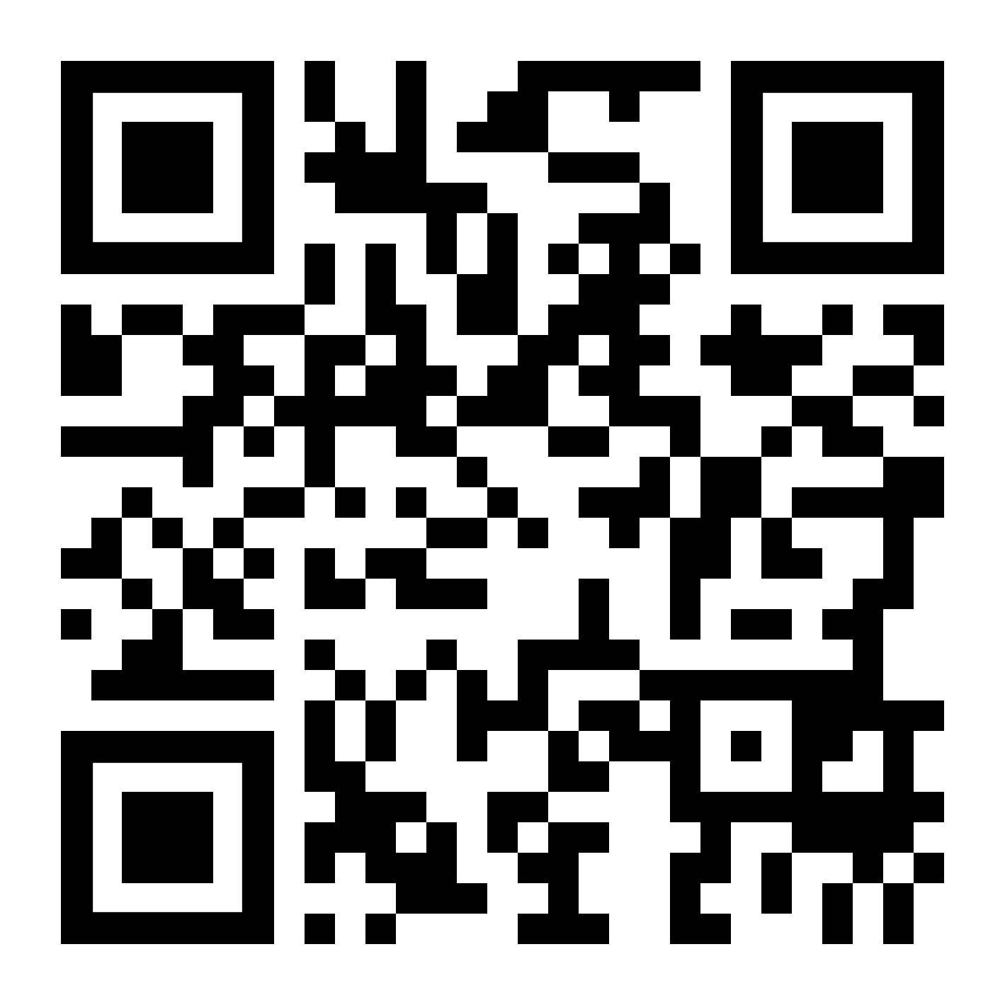

THANK YOU
Visit us
FOLLOW us
www.xjtlu.edu.cn
Notes:
Title: Uppercase, Calibri size 60, XJTLU Navy

